Slide 1
SCSJ1023 Programming Technique II
Sunday 3 Nov. 2019
Continue Tutorial 7
From Task 4
Task 1 to 3 have been done. Please use the update version of the material files
Do this tutorial by Pair Programming

Slide 2

Tutorial 7
Associations,
Aggregations and Compositions

Slide 3
Problem
In this tutorial, we are going to simulate bouncing balls inside two rooms. To simulate the bouncing effect, we are going to test whether the balls collide with the wall of the rooms. Each ball can only be inside a room. Each ball needs to know in which room it lives, so that later it can test whether it collides with wall of the room.

Slide 4
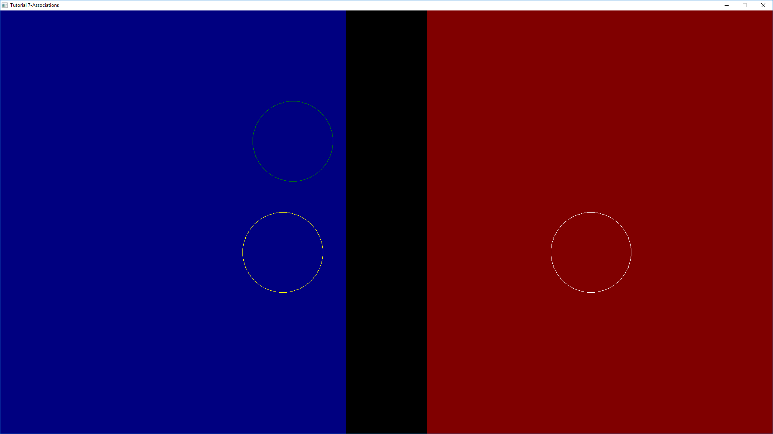
Expected Program:
Bouncing balls
Room 1
Room 2
ball 1
ball 2
ball 3
Run the program expected_program.exe

Slide 5
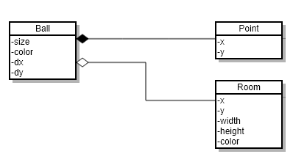
Class diagram
composition
aggregation

Slide 6
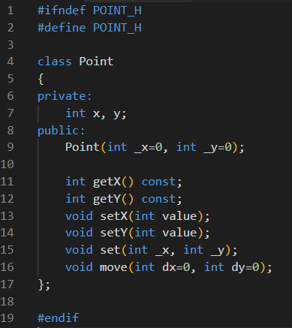
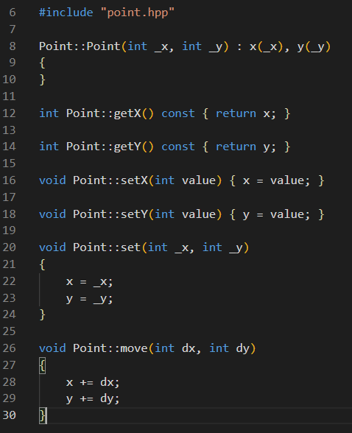
Task 1:
The code for class Point has been given. Review the code
point.hpp (class declaration)
point.cpp (class definition)

Slide 7
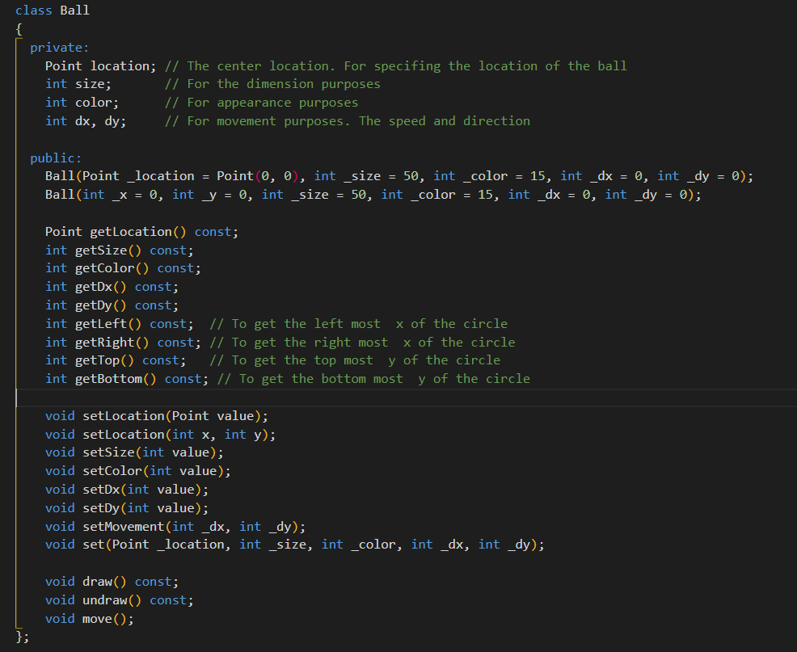
Task 2:
The declaration for the class Ball has been given. Review the code
composition
composition

Slide 8
Task 3:
Complete the class definition for the class Ball. The code some of the methods have been provided. Complete the rest
Refer to the following figure for the equations to be used in the methods getLeft(), getRight(), getTop() and getBottom()
A Circle object
top = y - size
size
location: (x,y)
bottom = y + size
left = x - size
right = x + size

Slide 9
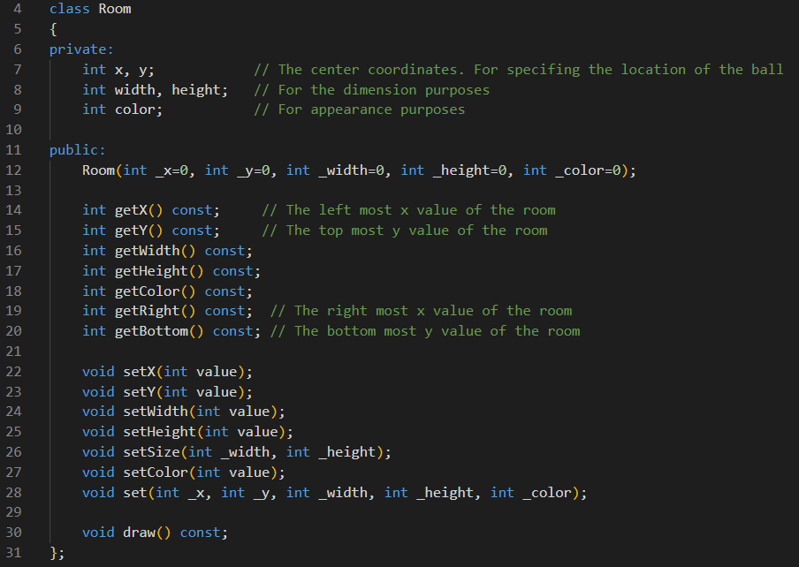
Task 4:
The code for the class Room has been given. Review the code
room.hpp (class declaration)
getY()
getRight(): x + width
getX()
(x,y)
height
width
getBottom(): y + height

Slide 10
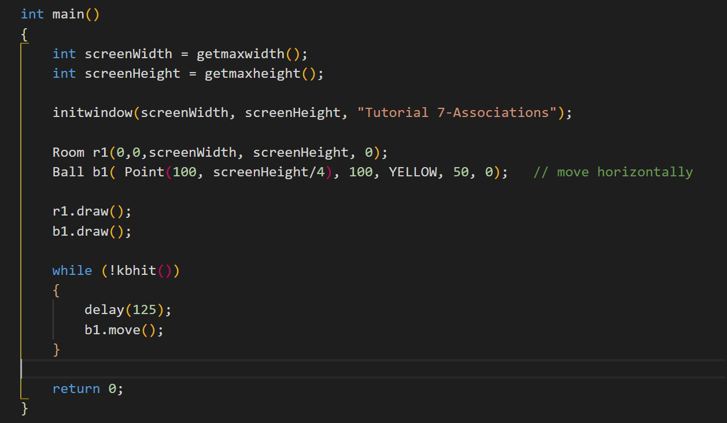
Task 5:
Review the main function

Slide 11
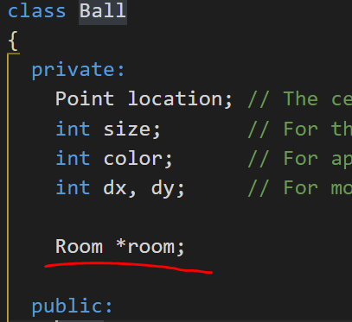
Task 6:
Modify the class declaration of Ball (in ball.hpp) to implement the “aggregation”
aggregation
In constructor, initialize the room pointer to NULL
Add new methods to the class Ball: getRoom() and setRoom()

Slide 12
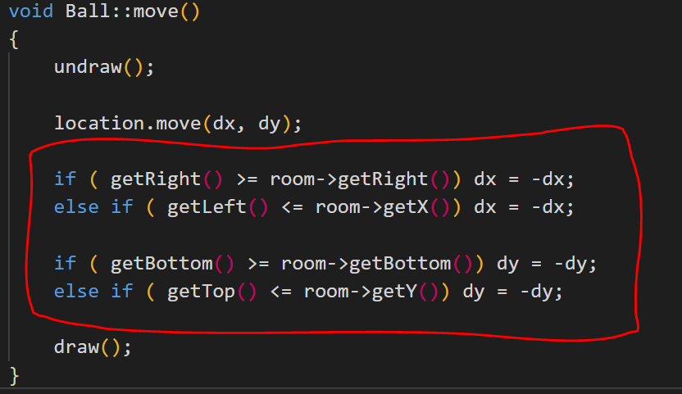
Task 7:
Modify the program such that the ball will bounce back when it reaches to the room’s borders (left, right, top or bottom border).
Modify the method Ball::move() (in ball.cpp)
The trick is to negate dx (and dy) whenever the ball hits the borders. The negation indicates that the ball changes its directions

Slide 13
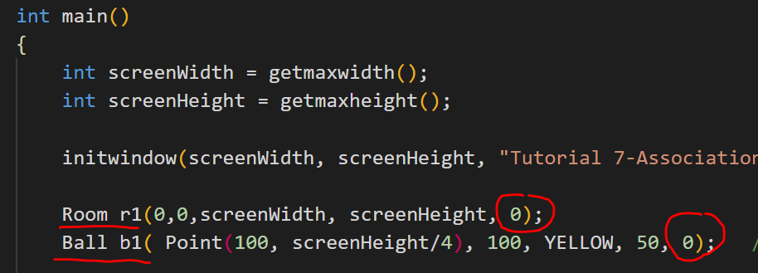
Task 8:
Modify the ball b1 (in main.cpp) so that it moves in both directions: horizontal and vertical.
Change the room r1’s color to BLUE
Run the program. Do you notice any problem? If so, modify the program to solve the problem.

Slide 14
Task 9:
Create another ball, b2 (in main.cpp) and link it to room, r1
Task 10:
Create another room, r2 (in main.cpp).
Create another ball, b3 and associate this ball to r2.

Slide 15
Task 11:
You might notice the balls move beyond the border.
Modify the method Ball::move (in ball.cpp) to solve the problem
The trick is whenever the ball is out of range (i.e., beyond the border), adjust its location.
Before adjustment
After adjustment

Slide 16
